Slide 1
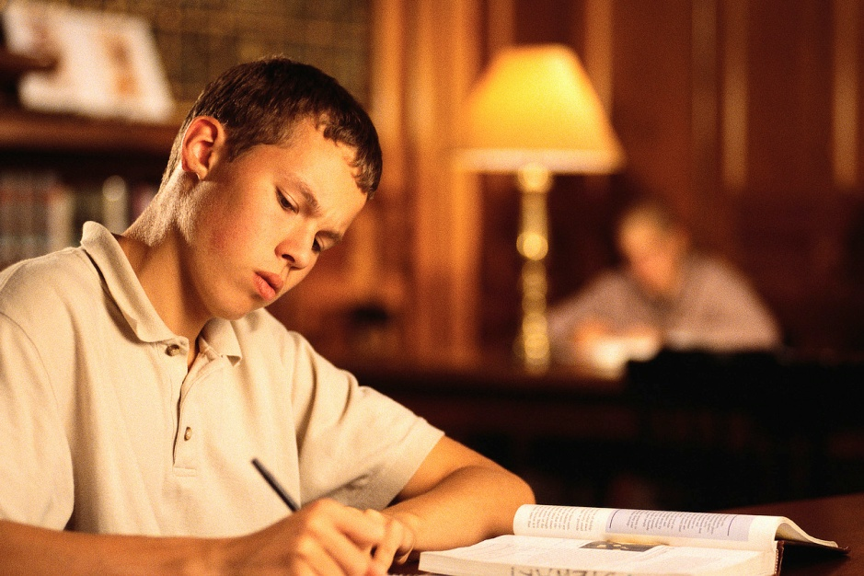
Copyrights
Respecting the Author
Respecting the Law

Slide 2
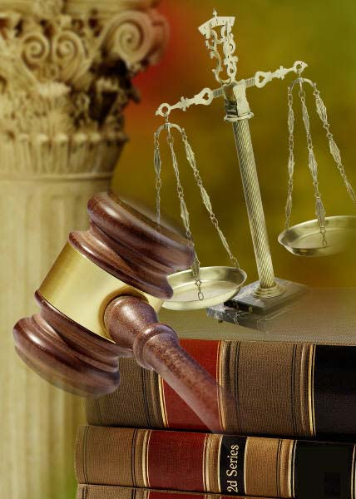
What is Copyright?
Protection for an author’s creation in the USA
Exclusive rights of owner to
Make copies of the work
Prepare derivative works
Publicly distribute, display and perform the work
Perform the work over a digital network (digital sound recordings)

Slide 3
What is Copyright?
Two fundamental criteria of copyright protection
Originality
Fixation in tangible form

Slide 4
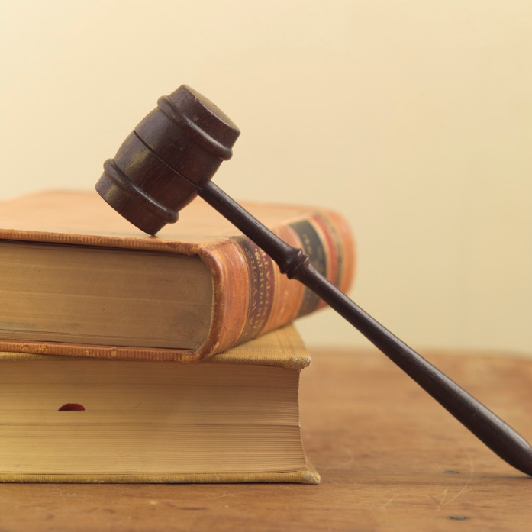
What is Copyright?
Primary purposes
Protection of the owner’s right to obtain commercial benefit ↔ $$$
Protection of the owner’s general right to control how a work is used

Slide 5
What is Copyright?
Protected works
Architectural works
Books
Electronic publications
Journal articles
Music
Movies
Paintings
Photographs
Sculpture
Software

Slide 6
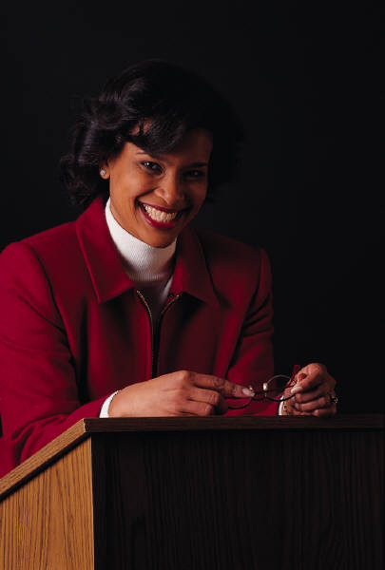
What is Not Protected by Copyright?
Works not fixed in a tangible form of expression
Improvisational speech
Dance choreography that is neither notated nor recorded
Processes, methods and procedures
Ideas and concepts
Titles, names, short phrases and slogans
Information that is common property with no original authorship
Standard calendar, tape measure, weight chart

Slide 7
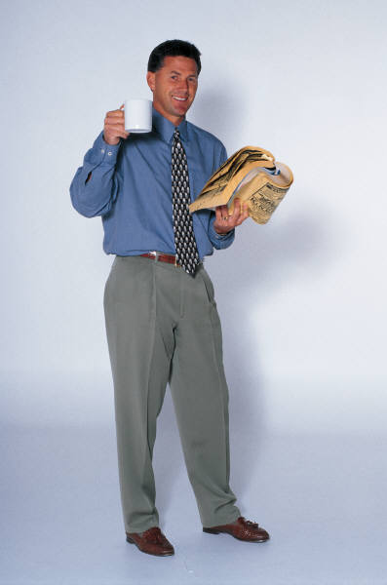
Anyone May Freely Use
Facts
Ideas
Works that lack originality
The phone book
Works in the public domain
Works published on or before December 31, 1922
U.S. Government works
List or table taken from a public document

Slide 8
What if I Own Copyrighted Material?
The public enjoys rights to use their own copies of copyrighted material to
Display
Lend
Give away
Sell
Reproduce parts (in certain circumstances)
Reproduce the entire work (in some cases, as a Fair Use)

Slide 9
What is Fair Use?
Allows copying of copyrighted material done for a limited and transformative purpose
A limitation to the copyright owner’s exclusive rights to copy or to authorize others to copy the work
Complex doctrine
Not clear-cut

Slide 10
What is Fair Use?
Transformative use
The use adds value to and repurposes the work for a new audience
Limited use
The amount of material to be used is appropriate to achieve the transformative purpose

Slide 11
What is Fair Use?
Conditions that support our relying on Fair Use
Difficulty in acquiring the work
Difficulty in gaining access to the work
Difficulty in obtaining permission to use the work

Slide 12
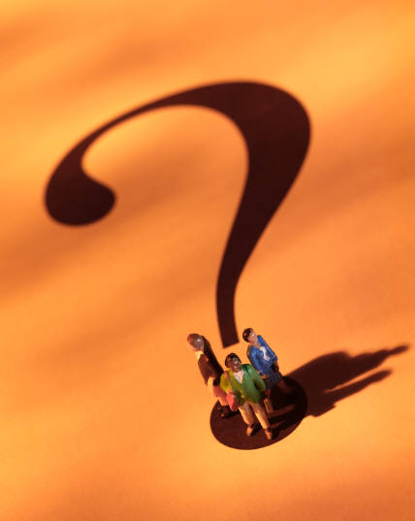
What is Fair Use?
Ask Yourself
Why couldn’t I just rewrite it in my own words?
“Is the use [I] want to make of another's work transformative -- that is, does it add value to and repurpose the work for a new audience -- and is the amount of material [I] want to use appropriate to achieve [my] transformative purpose? “
http://copyright.lib.utexas.edu/copypol2.html

Slide 13
What is Fair Use?
Ask Yourself
Does the copyright owner make the work available on the open market ?
Is there an efficient, effective way to
buy or access the work for my use?
obtain the owner’s permission to do what I want to do?

Slide 14
When in Doubt About Fair Use
The safest course of action is to get permission from the copyright owner before using copyrighted material.

Slide 15
Fair Use in School
Typically, a faculty member may copy an entire article from a journal for students in a class.

Slide 16
Fair Use in Action
Typically, a student writing a paper for a class assignment could include lengthy quotes.

Slide 17
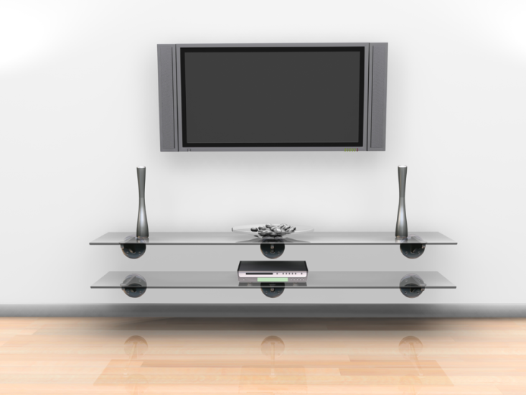
Fair Use in Action
Typically, a teacher can record a television program transmitted by networks or cable, provided the teacher shows it in class within the first 10 days, and provided the teacher deletes or destroys it within 45 days.

Slide 18
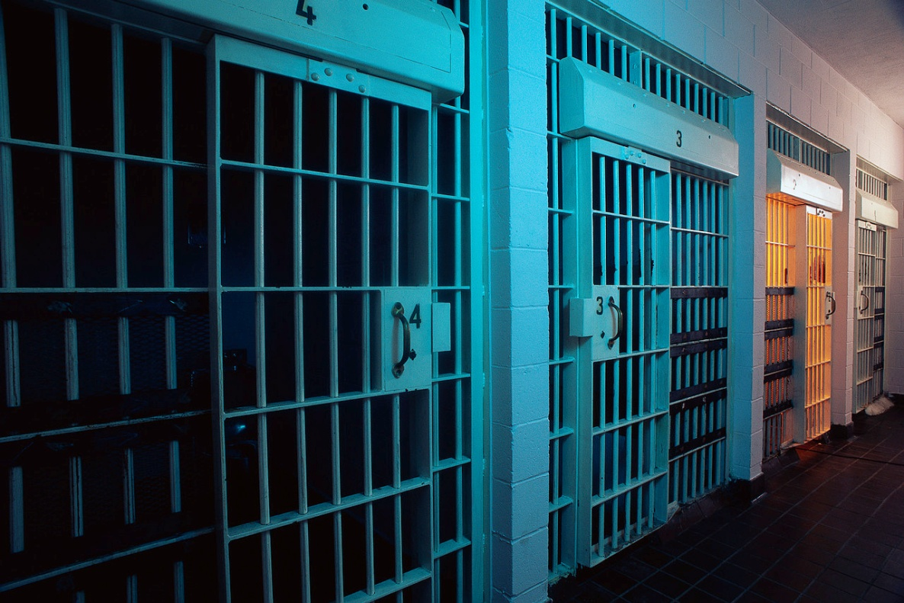
Is Copyright Violation a Crime?
Commercial copyright violation is a felony when it
Involves more than 10 copies
and
Has a value over $2500

Slide 19
Copyrighted Works at School
Limit materials distributed in course packs to
single articles or chapters, or other small parts
several charts, graphs or illustrations
small parts of works such as performances (audio, video)
copies of materials that you or the library already legally possesses
Always include
any copyright notice on the original
appropriate citations and attributions to the source

Slide 20
Copyrighted Works at School
Limit access to the appropriate groups
students enrolled in a class
administrative staff, as needed
End access at the end of the class

Slide 21
Check your Copyright Knowledge
See if you can answer these copyright questions. Click the mouse for the answers.
Question
Answer
Ideas cannot be copyrighted.
True
If you do not have a copyright notice, it is not copyrighted.
False Assume that other people's works are copyrighted and may not be copied unless you know otherwise.

Slide 22
Question
Answer
Copyright protects text and pictures on the Internet
True
Copyrights must be registered to secure protection.
False Registration may be a good idea, because you may get certain additional benefits; but copyright protection begins at the moment the work is created on paper, recorded or otherwise made permanent (fixation in tangible form).
Quoting three lines from a Beatles song in a music review in the school’s newspaper would be considered Fair Use.
True

Slide 23
Copyrights
Respect the Author
Respect the Law

Slide 24
Resources
http://www.copyright.gov/
http://www.copyright.gov/circs/circ01.pdf
http://www.loc.gov/teachers/copyrightmystery/#/copyright/
http://fairuse.stanford.edu/
http://www.templetons.com/brad/copymyths.html
http://www.ncpublicschools.org/copyright1.html
http://www.copyright.com/
http://copyright.lib.utexas.edu/
http://www.law.cornell.edu/uscode/text/17/102
http://fairuse.stanford.edu/Copyright_and_Fair_Use_Overview/chapter9/9-a.html

